Slide 1
Project Presentation CSEE 5590-0002 : Web/Mobile Programming
KC Donation
Team 3 :
Roshna Toke, ClassID: 23
Manaswini Vedula, ClassID: 24
Yamini Saraswathi Bommineni, ClassID: 03

Slide 2
Objective
The main objective of this project is to design a system where donors (those who have excess items) can donate their items only by posting its description on the system and then the requester will request that as per their need and collect from a given address.
Inspiration from existing project
Needs are the primary essentials. Many people suffer from them because of a shortage of items and at the same time lots of excessive items have been Trashed. So, the main motivation of this application is to create a bridge between the Donor and users and making excessive items to reach for the people who are in need.

Slide 3
System Features:
This application has user to user interaction.
Those who have access items and want to donate, they can post the same in application.
When donor post the item, all the requester will get an email notification.
If requester needs any item, then he can just request that item. There is no need of donor approval as if there is requester needs on urgent basis and donor did not accept for any reason then it won’t help to requesters.
Requester simply request any item and collect it from given address and can also view specific type of items.
Both donor and requester can their history of donation and requested item respectively.
Both donor and requester can update their profile information.
If user forget his/her password, we will send random password his/her registered email id.

Slide 4
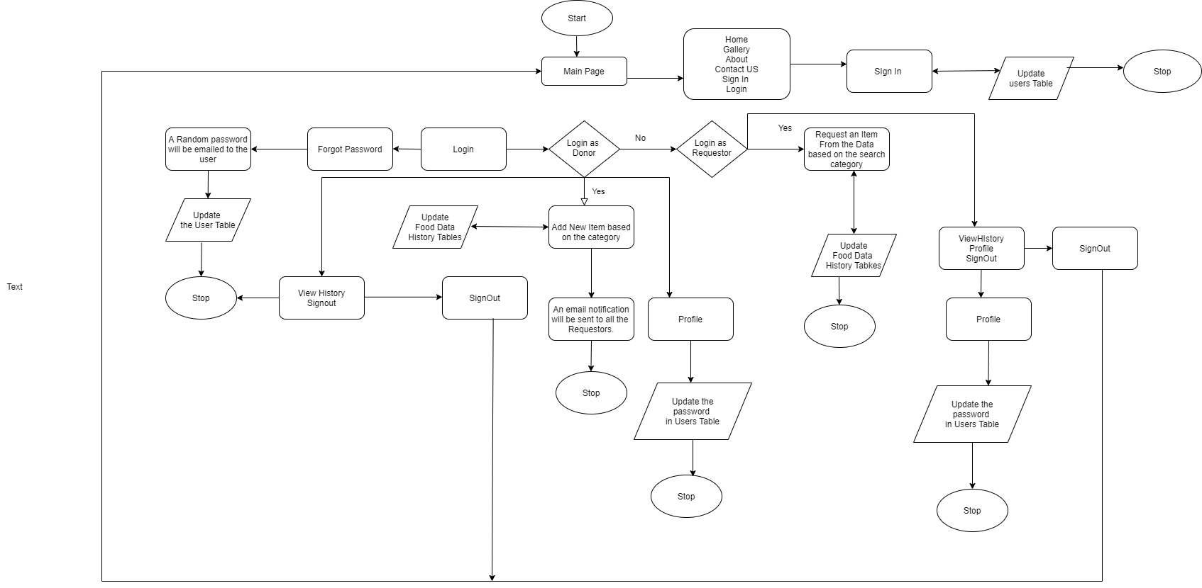
Architecture Diagram

Slide 5
Contribution
1. Roshna Toke – Login Page, Registration Page, Donor Page Functionality, History Table, Email Functionalities
2. Manaswini Vedula – Requester Page Functionality, Database connection, User table, Data Table.
Yamini Saraswathi Bommineni – Main Page Functionality, Architecture Diagram

Slide 6
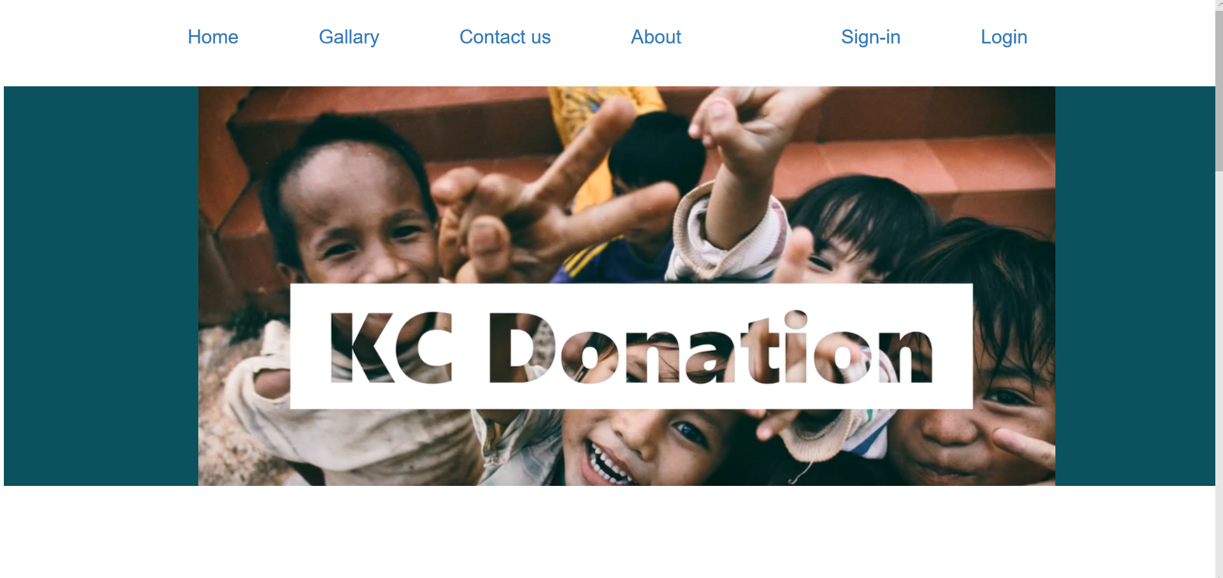

Slide 7
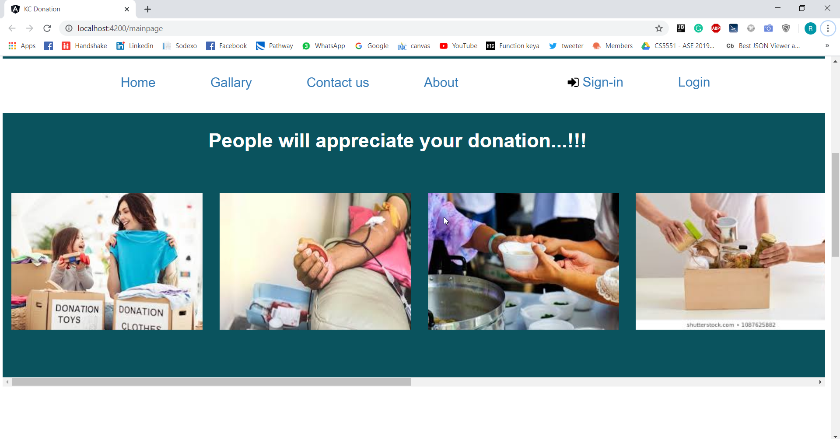

Slide 8
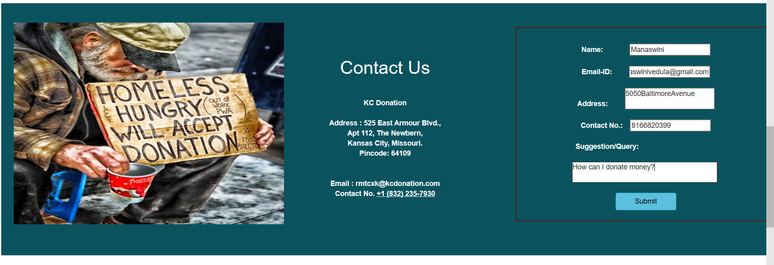

Slide 9
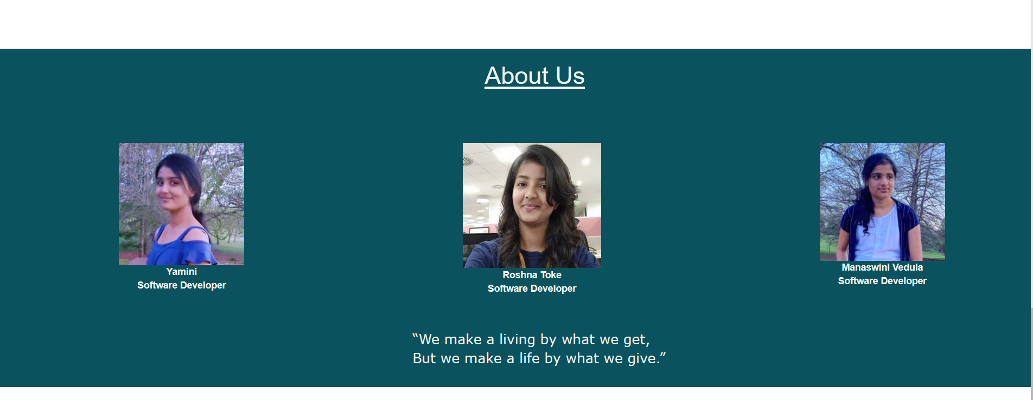

Slide 10
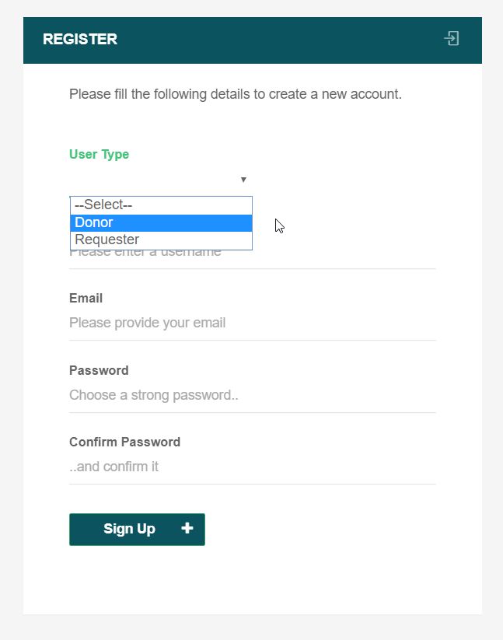

Slide 11
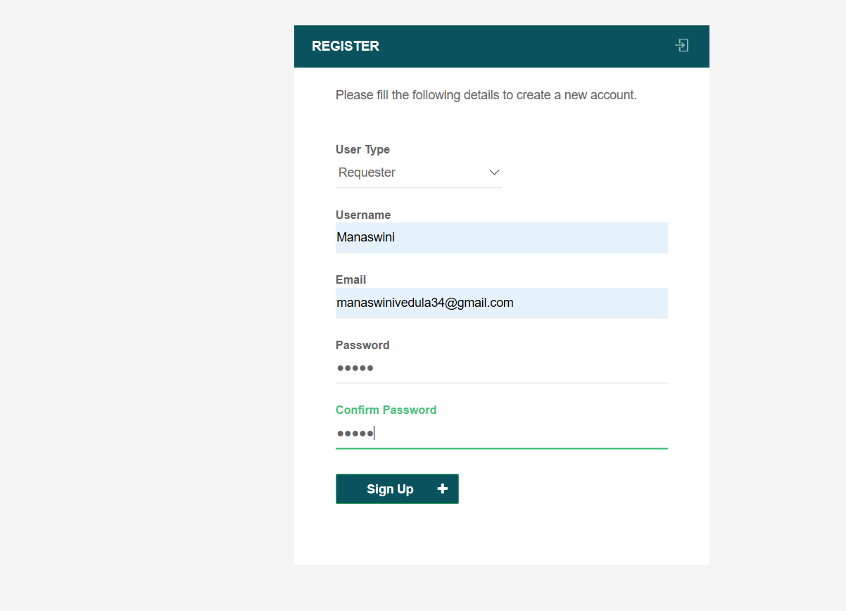

Slide 12
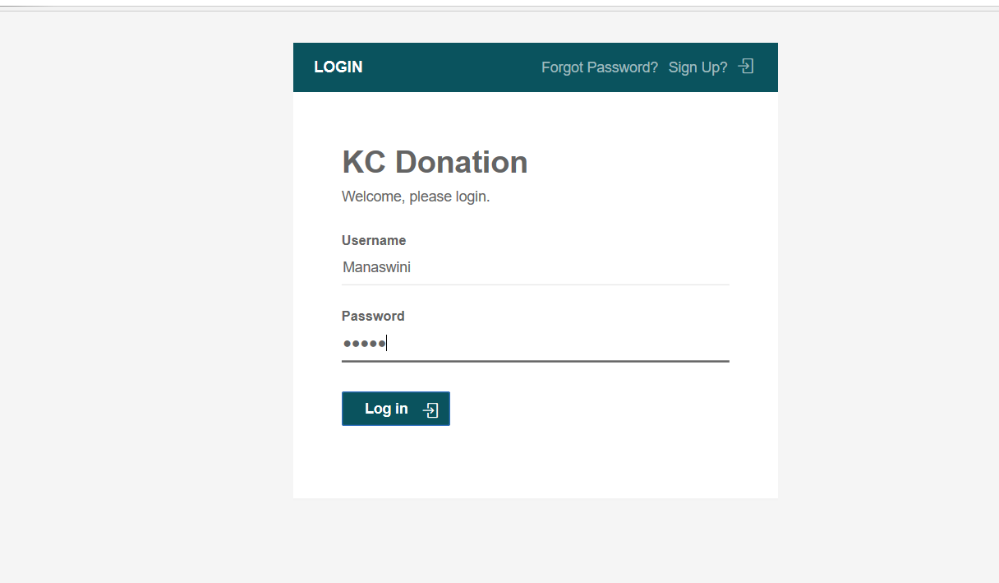

Slide 13
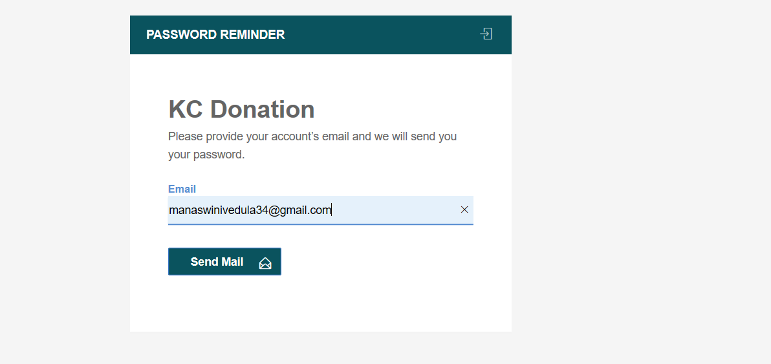

Slide 14
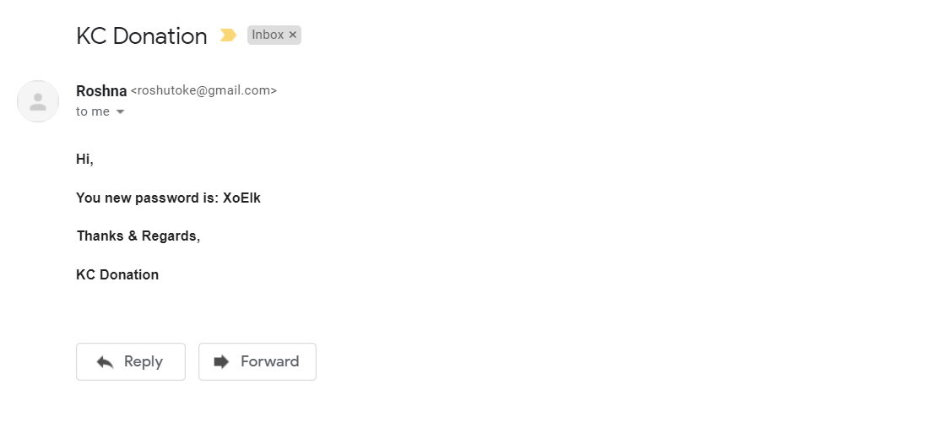

Slide 15
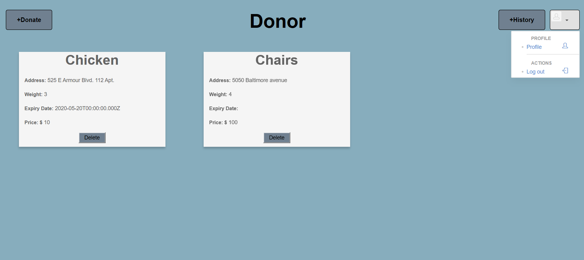

Slide 16
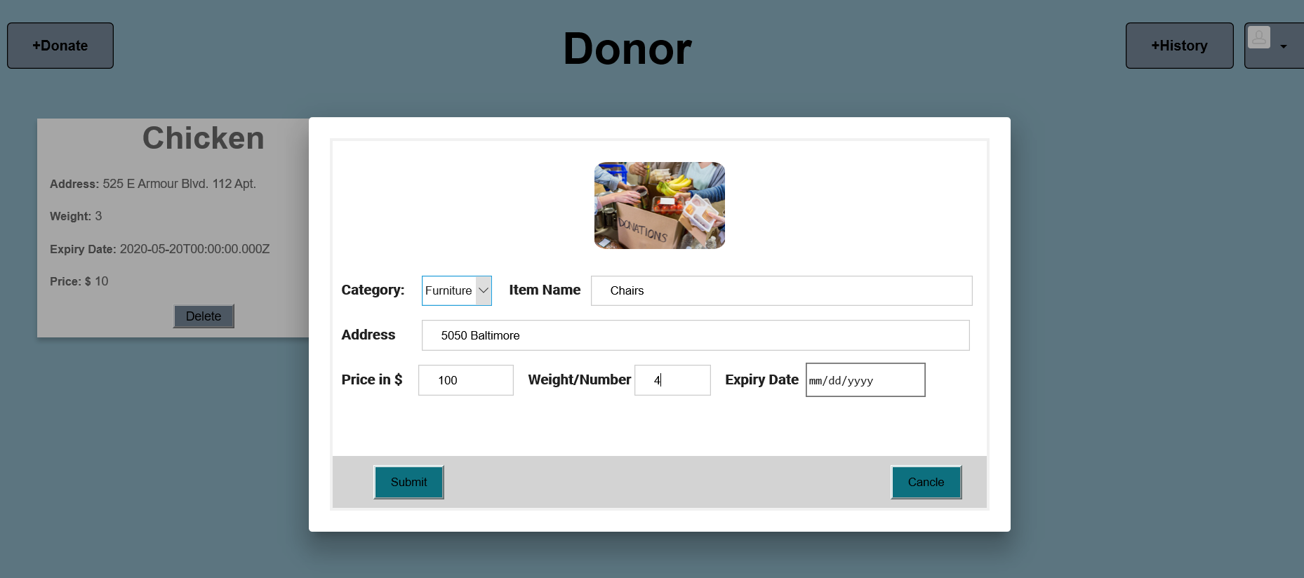

Slide 17
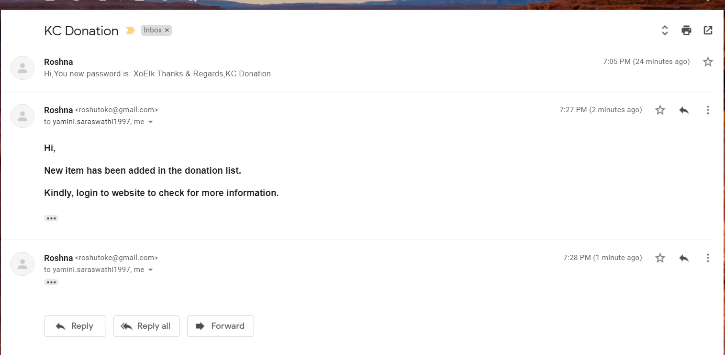

Slide 18
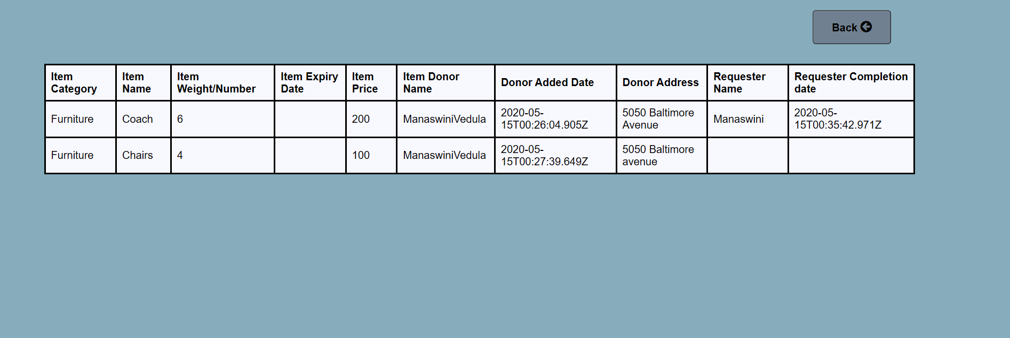

Slide 19
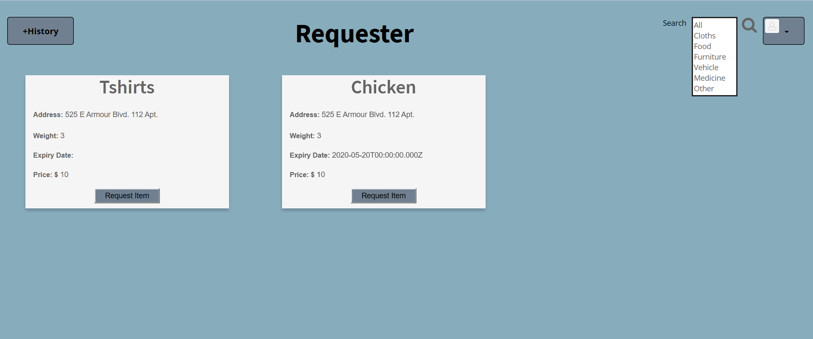

Slide 20
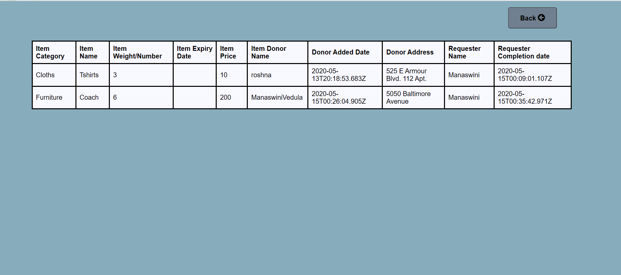

Slide 21
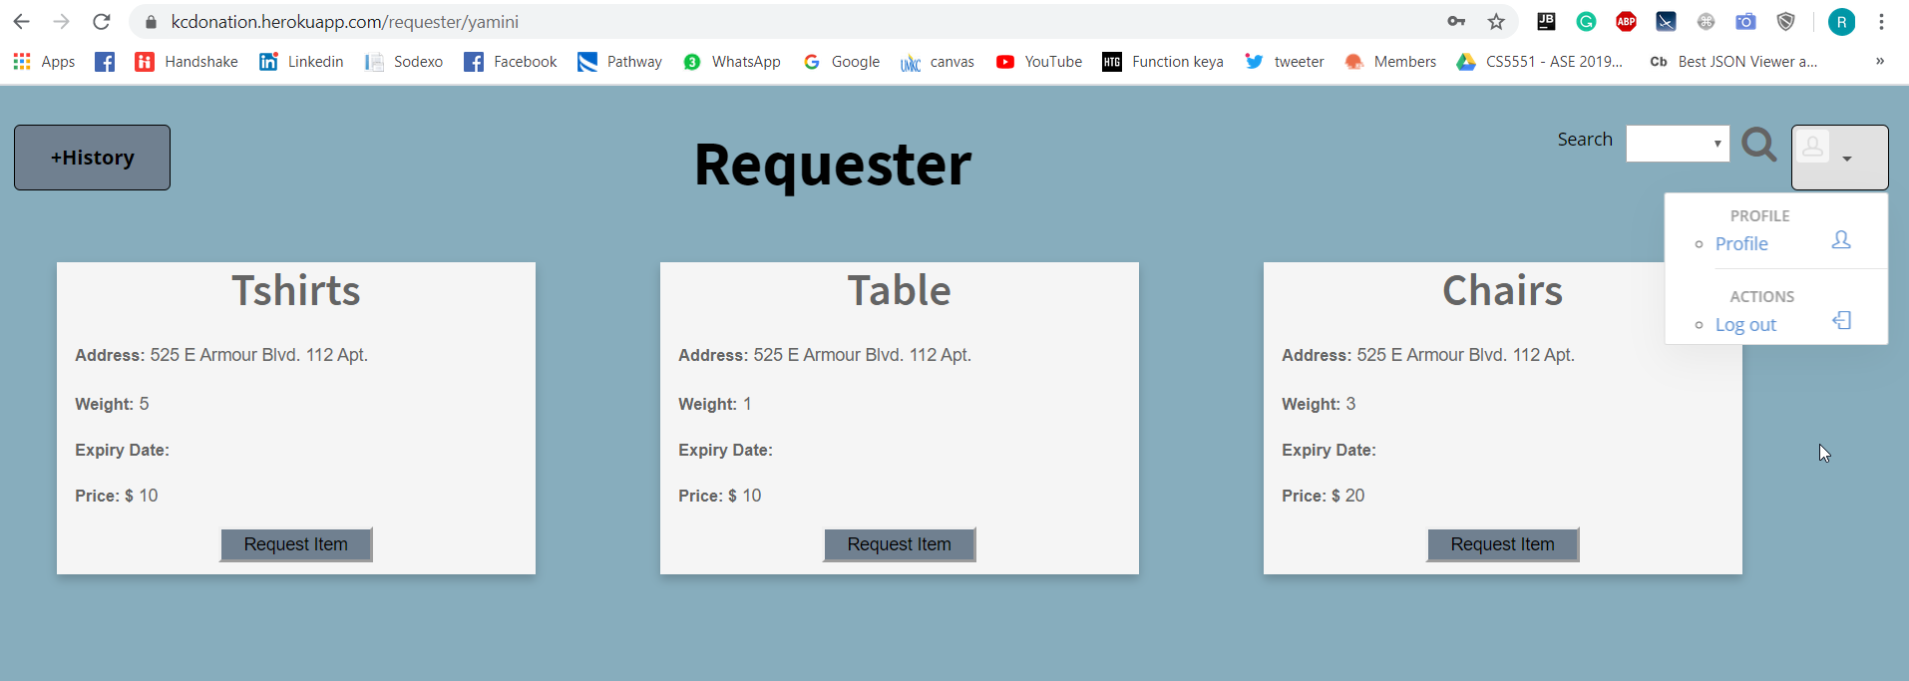

Slide 22
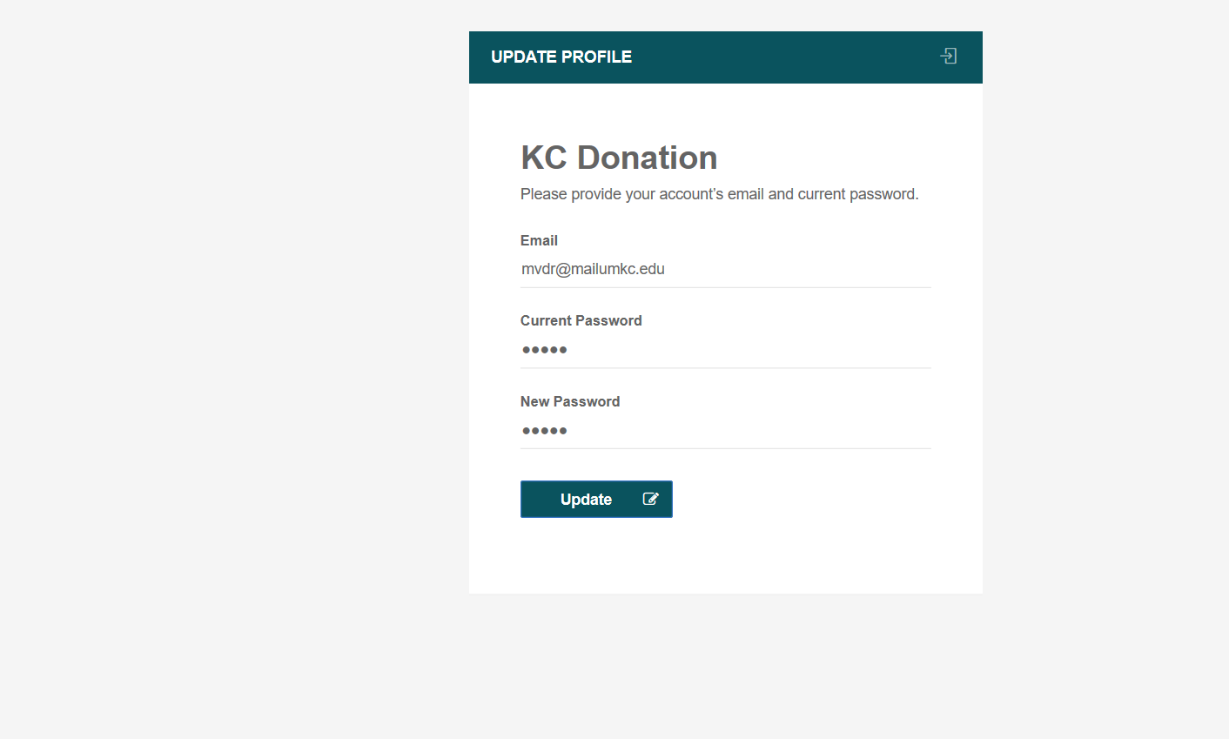

Slide 23
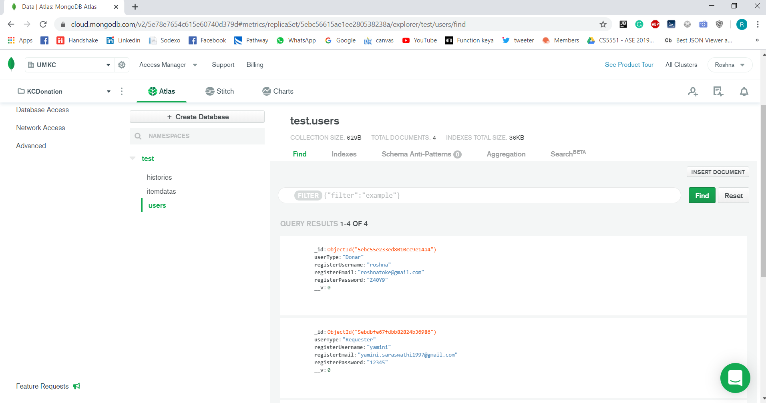

Slide 24
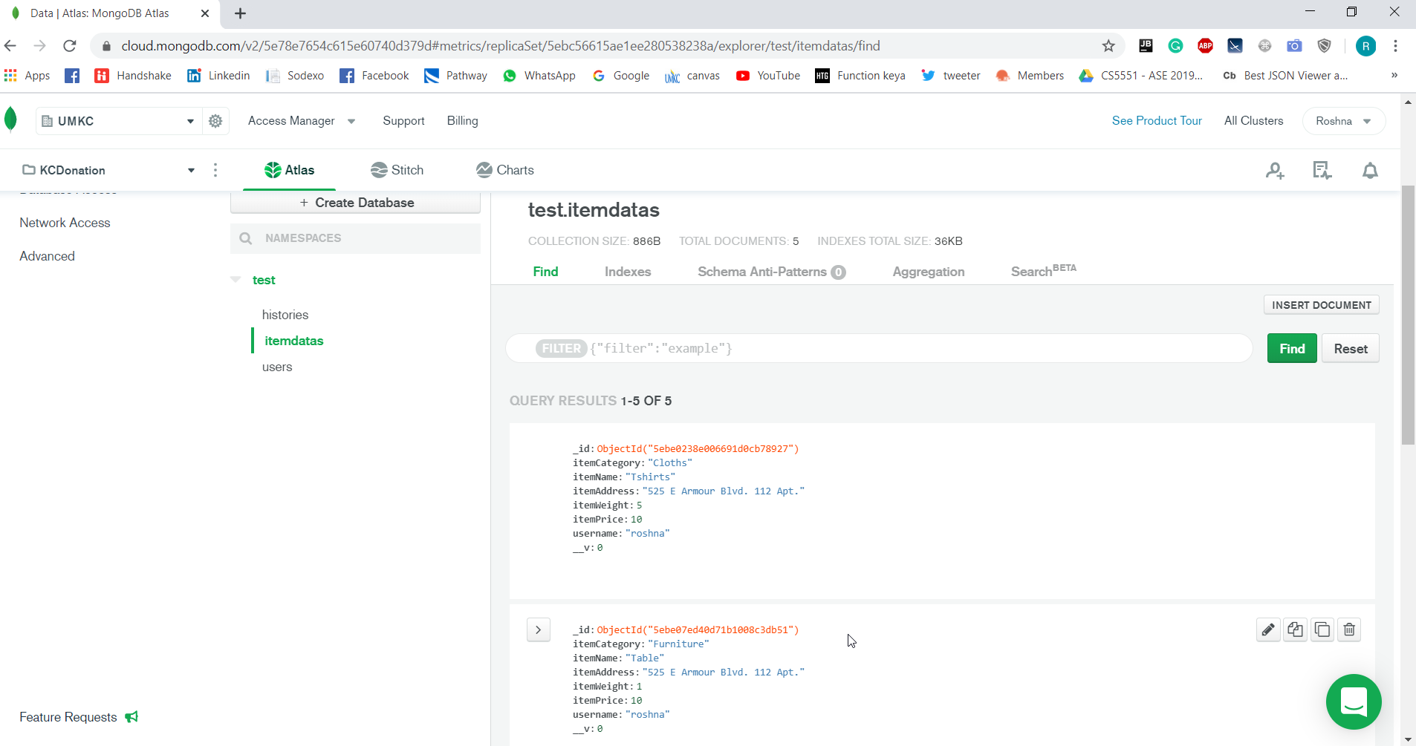

Slide 25
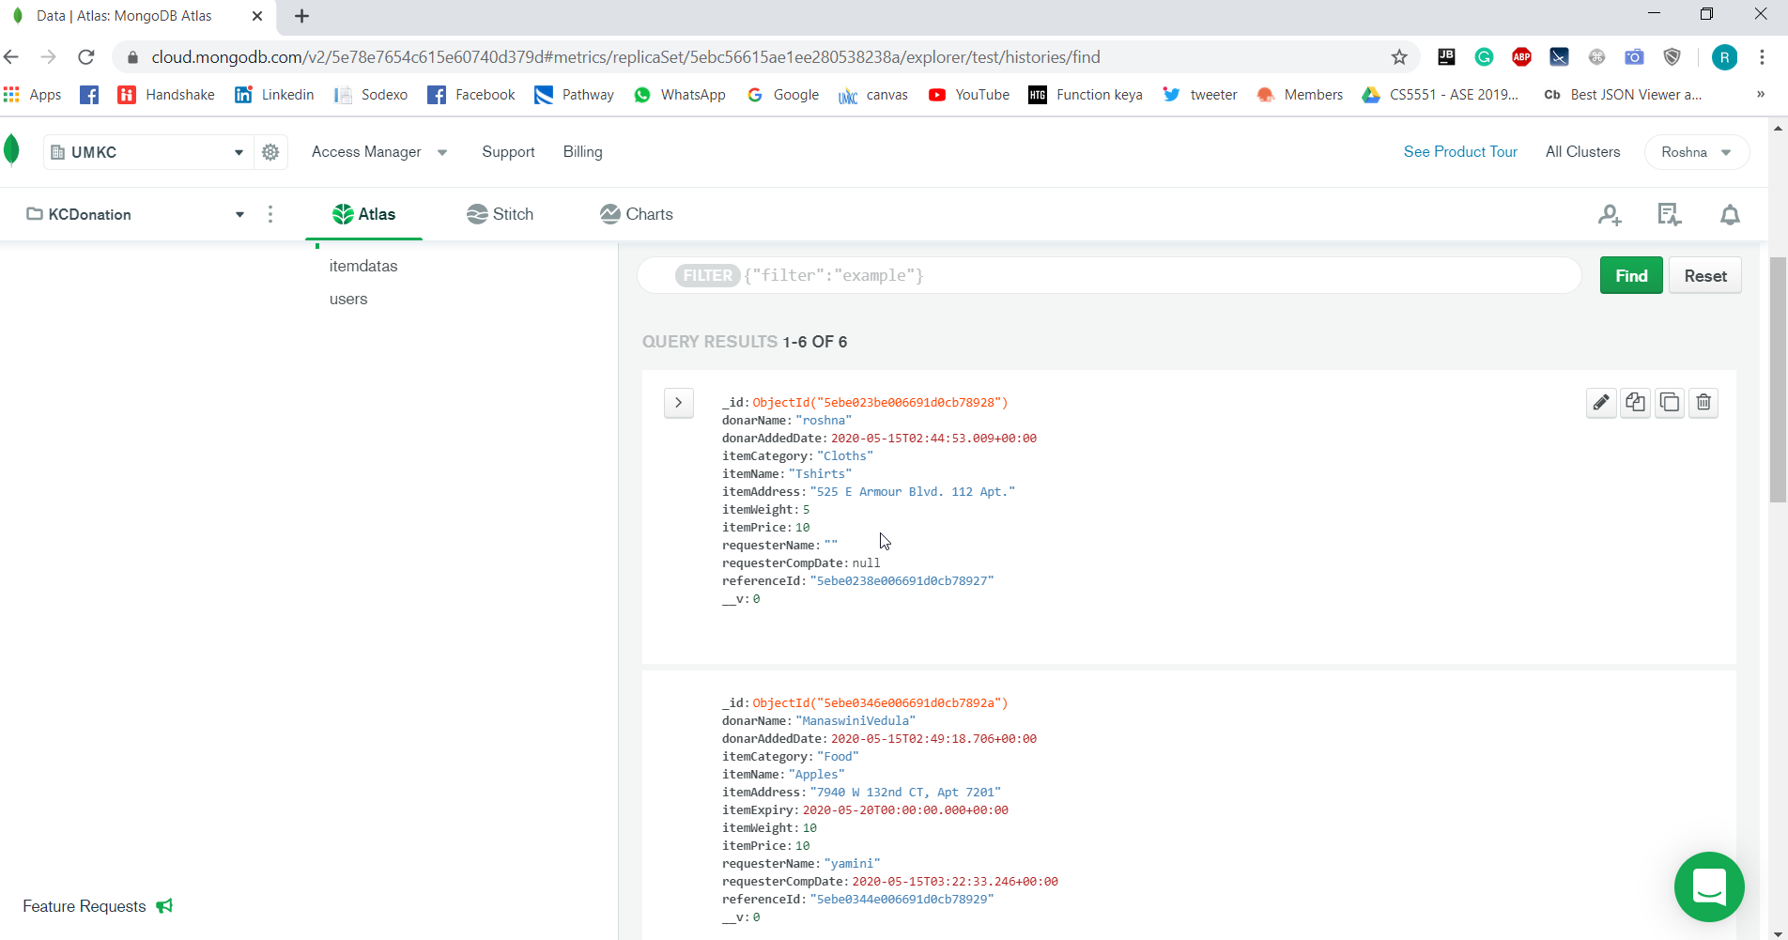

Slide 26
Technologies used
MEAN stack
Angular JS
HTML, CSS, Bootstrap
Node JS
Mongo DB
Heroku cloud deployment Link
https://kcdonation.herokuapp.com
GitHub Link
https://github.com/roshna1924/KC-Donation
https://github.com/manaswinivedula/KC-donation

Slide 27
References
1. Hackathon Use Case - https://umkc.app.box.com/s/gg46llw7gye4is7ujhohw00a2sody7mb
2. https://www.w3schools.com/
3. www.google.com
4. https://mongoosejs.com/docs/api.html
5. https://themeforest.net/search/oneui

Slide 28
Thank You

